Slide 1
19 AIE 102
DIGITAL MANUFACTURING
(GROUP PRESENTATION 1)

Slide 2
GROUP MEMBERS
1) J. SAI CHANDANA (aieb.1008660)
2) T. CHARISHMA CHOWDARY(aieb.1018623)
3) JAIDEV(aieb.1024213)
4) M. PRANISH KUMAR(aieb.1025392)

Slide 3

1.What is post processing. Provide and explain a few examples of post processing in 3d printing ?
A) Post processing :-
Post processing is the process of editing the data captured by a camera while taking the photo taken to enhance the image.
post-processing in 3D printing refers to any process or task that needs to be performed on a printed part, or any technique used to further enhance the object. Think of it as a finishing touch to treat and refine parts that come out of a 3D printer.
Benfits:-
1.Advance time-to-market turnaround. Consumers want products that work for their lifestyle.
01
2.Save on tooling costs with on-demand 3D printing.
02
3.Reduce waste with additive manufacturing.
03
4.Improve lives, one customized part at a time.
04
5.Save weight with complex part designs.
05

Slide 4
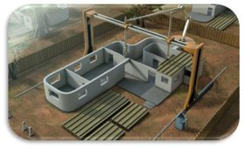
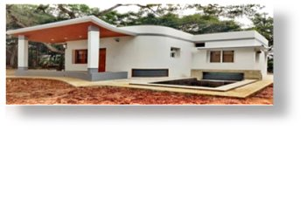

Provide and explain a few examples of post processing in 3d printing ?
1.homes and Buildings :-
Believe it or not, 3d printing has the ability to produce entire houses in buildings. This is a remarkable feat for the technology because it could potentially save lives when areas are enduring tough times from things such as natural disasters and war because emergency shelters can be constructed quickly and on-demand using 3d printing technology. In Moscow, Russia, a team used3d printing to create a 400 square foot house in less than a day, just to point out one instance of the production speed.
In addition to this, 3d printing is also enabling the development of new architectural designs and visions that before were never possible. The design innovations are seemingly limitless. In Holland, there will soon be a small neigbourhood consisting solely of3d printed homes .

Slide 5
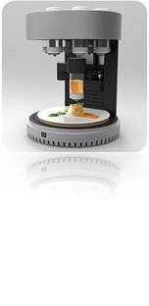
2. Food :-
3d printing is even breaking design barriers in the culinary arts. Using a plastic 3d printer , users can actually print chocolate based off a digital design from 3d software . Companies have even 3d printed edible foods using ice cream, cookie dough, marzipan and hamburgers
3. Firearms & Military :-
A very controversial topic has been the ability to 3d print fully functional firearms. Defense Distributed’s “Liberator” has been subject of hot discussion as it is a working plastic gun, created using 3d printing technology. Many believe this to be an extremely dangerous ability as there is the potential for any person with a3d printer and the design blueprints can produce their own guns.
3D printed flip-top valve on the T-45 Goshawk breathing mask. Photo by Emanuel Cavallaro via NAVAIR.
In a more positive light, branches of the U.S. Military have benefited greatly from this ability. Already we have seen many instances of how 3d printing can aide soldiers in the battlefield and potentially save lives:

Slide 6
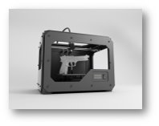
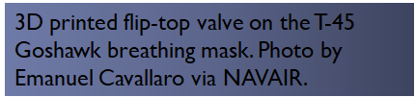
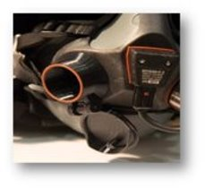
Click to •U.S. Marine Corps Turns to 3D Printing
•U.S. Army Explores 3D Printing Stealthy Squid Drones
•U.S. Navy Will Depend On 1,000 3D Printed Parts by the End of 2018
•Marine Corps Seeks to 3D Print Drones, Save Thousands
•3D Printed F-35 Part Saves U.S. Marines $70,000
•Department of Defense Unveils 3D Printed Drones Deployable from Fighter Jets
•EDA to Assess Usage of 3D Printing in Military Operations

Slide 7
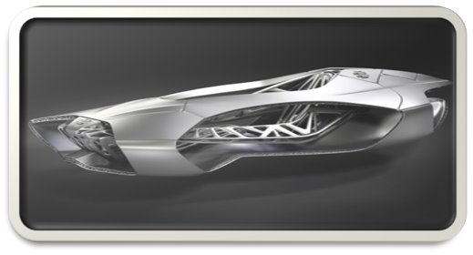
4.customized 3D printed cars:-
Genesis, the 3D printed car inspired by turtle shells
EDAG also created a 3D printed car called Genesis. But that one’s not exactly a vehicle, it’s more of an innovative physical concept. It increases the safety of passengers thanks to a revolutionary structure, inspired by turtle shells, produced using the selectively laser sinteringsls technology .
Inspiration:-The turtle benefits from millions of years of evolution for their protective shell, which makes it quite optimized by nature. But reproducing such types of structures is not always an easy task. Additive manufacturing makes it possible to produce such complex geometries.
Results;-The optimized structures performed really well in crash tests

Slide 8
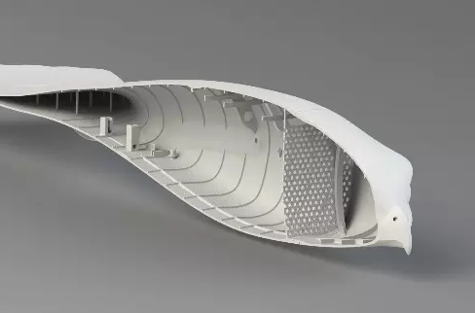
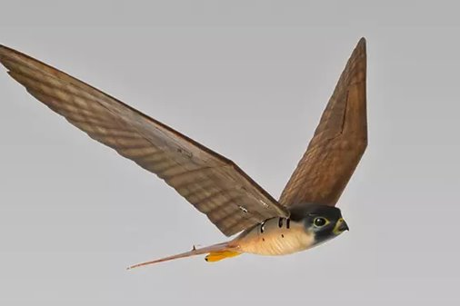
5. Robot Birds:-
Birds are beautiful creatures. However, they can endanger passenger safety by damaging an aircraft, spreading disease or ruining crops. In response, Dutch company clear fight situations has created high-tech “Robirds”.
These remote controlled robotic birds of prey, with the realistic appearance and weight of their living counterparts, serve as modern-day scarecrows. Robirds propel themselves by flapping their wings, with a flight performance comparable to real birds.”
here Robirds can be used at airports, orchards, fields, and waste sites to scare away the real and much peskier birds. They have developed two types of Robirds: the falcon, which can be used to chase off birds up to 3kg, and the eagle to chase away any type of bird.

Slide 9
2. Provide a few examples of torubleshooting in 3D printing
There are a lot of things that are cool about 3D printing. It gives designers the ability to handle any level of complexity. It ensures pinpoint accuracy. The things you can make are limited only by up imagination. And it delivers the promise of mass customization.
Problem is, I just don’t think it’s quite right. This technology was supposed to revolutionize manufacturing: Put creativity in everyone’s hands! Disrupt the production model! A printer in every home!
To try and focus the problem, here are some lamentations with the state of 3D printing.

Slide 10
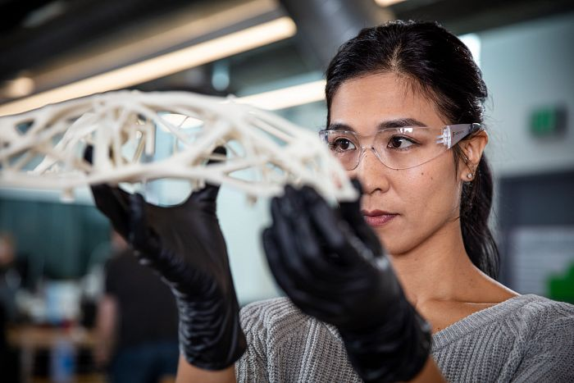
1. Output/Quality Problems With 3D
Printing
In some ways, this is the most basic thing, but there are many quality-related problems with 3D printing today:
Fragile, delaminated fused-deposition-modeling (FDM) parts
Low-resolution output
Materials
Now, to be fair, the materials are defined by what can be extruded, squirted, or melted, but this is not based on their application or final use. And even though there are some examples of multimaterials, it’s typically only two at a time. So that’s a constraint.
But here’s the point: It’s important to shift the emphasis in 3D printing from “Look, I made something!” to “Look what I made!” It has to be consistently high quality, using great materials for 3D printing and producible in no other way.

Slide 11
2. Too Much Time Spent on 3D-Printer Troubleshooting
The complexity of just getting the process to work is often daunting, and it involves too much fiddling with formats, parameters, and adjustments to avoid mechanical failures.
You all know the joke by now:
Why are 3D printers transparent?
So you can watch your build fail!
I know it’s so that you can see what’s going on, but mostly it’s so you can intervene when the process breaks down.
It’s to the point where people install cameras to watch their printers! Can you imagine standing there and staring at a 2D printer to make sure it was behaving properly? Of course not.
It is time to shift from the obsession with 3D printers and 3D printing and focus on what is being 3D printed. Who cares if I have a great 3D printer, and I’m having a great time 3D printing? What I want is the output.
I look forward to the day when 3D printers are not transparent, but the path from design to fabrication is clear—when the whole process is so reliable and high quality that 3D printing experiences the wonderful fate of any successful technology: ubiquity and invisibility.

Slide 12
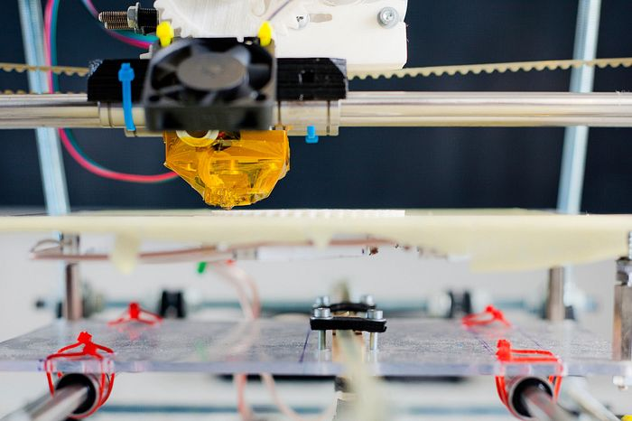

Slide 13
3. The 3D-Printing Workflow Should Incorporate Computer Designs
The workflow is old and outdated, and it’s still based on the classic linear approach:
Human: Design
Computer: Document and Analyze
The 3D-printing workflow usually doesn’t take advantage of generative design or other manufacturing breakthroughs. The problem with the current workflow is that, first, designers are drawing stuff, and then the robot is drawing stuff again in the 3D printer.
That means people are still designing the same old parts and then somehow expecting the 3D-printed outcome to be unique. As long as people’s drawing capabilities are in the way, they’re squandering the power of 3D printing.
It would be better to delegate more of the actual design to the computer. In fact, if designers fully adopted that mindset, they could permit the software to come up with designs more elaborate than anything they could draw.
Using the old mindset, where designers have to do all the work, the outcome of their efforts will always be restricted by their limitations of time, money, and patience. They’re often limited to just one or two choices at a time and then just printing the better one, not the best possible design.
Here’s a critical mindset switch: Designers have to stop thinking of their computers as mere drawing tools. They’re not just for execution. They should expand exploration.

Slide 14
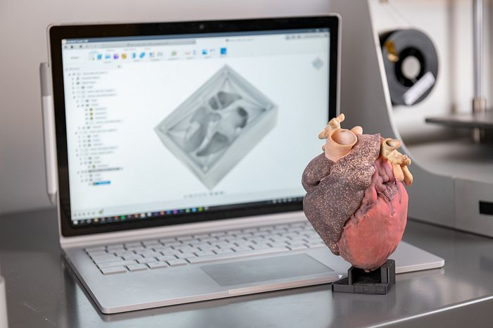
3D Printing Should Create New Solutions
The fourth lamentation is that people have been aiming at the wrong target with their 3D-printing efforts.
They’ve been happy creating prototypes, replacement parts, and trinkets—but what they should be focused on are final parts and creating novel solutions to higher-level problems.
In order to reach this new target, it’s important to look at 3D printing holistically, through four facets of additive manufacturing: part, system, material, and process.
In other manufacturing processes, you could separate these four ideas and optimize each separately. But in 3D printing, they all come together because they all affect each other. The best way to achieve assembly function is through materials. Springs, levers, hinges, and dampers can be achieved, not only via individual parts but also through clever in-process materials. Understanding the relationship between interacting elements is key.

Slide 15
5: The 3D-Printing Industry: It’s Prematurely Mature
My last 3D-printing lamentation is that 3D-printer manufacturers seem to be prematurely solidifying standards and stifling innovation. Today, 3D-printing’s problem is that the market remains “prematurely mature.”
Manufacturers are unfortunately mistaking that smaller, earlier chasm for the bigger one ahead. Customers are the enthusiasts, not the majority. Yet manufacturers are using business models meant to optimize later phases as if there were already a printer in every home.
But that’s crazy because this is still the first phase, where open innovation should still be predominant. Instead, you see manufacturers put ID chips in material cartridges so they can’t be refilled or sourced elsewhere.
Doing that gets you fascinated with material sales, and then you start doing dumb things like overprinting support materials, as opposed to addressing the real customer need, which is that they don’t want support materials at all!
Thinking like this brings you to an impasse because you put the business ahead of the customer. Everyone must agree that the industry is not done innovating yet.
So here are my five problems with 3D printing (lamentations) and their potential cures summed into one sentence: Designers need to solve problems with new solutions, less effort, more results, greater expression, increased reliably and confidence, and good quality.

